Slide 1
Denoising Speech from Background Noise
EC523 Final Project
Tamerlan Baimurat, Michael Lwe,
Punnisa Amornsirikul, Jiaxing Wang
April 30, 2026
Notes:
Tamerlan
10 minutes of presentation
just to remember in case we forget from TA:
presentation should be focused on comparing our results with the baseline along with ablation
we should focus on our motivations and talk about that (we want to classify noise, not necessarily denoise)
do NOT need to show loss function graphs as ours doesn't really say anything

Slide 2
Agenda
Background & Motivation
Baseline Model
Our Model
Training
Results
Next Steps
Notes:
Michael

Slide 3
Motivation
Real-world audio is often corrupted by background noise
Denoising the background audio can capture audio of interest
Blind noise suppression can degrade clean audio
We introduce a classification step before denoising
Denoising is conditional on the probability from classification
Challenges:
Overlapping signals can create ambiguous mixtures
Risk of overfitting due to diverse noise types
Notes:
Punnisa

Slide 4
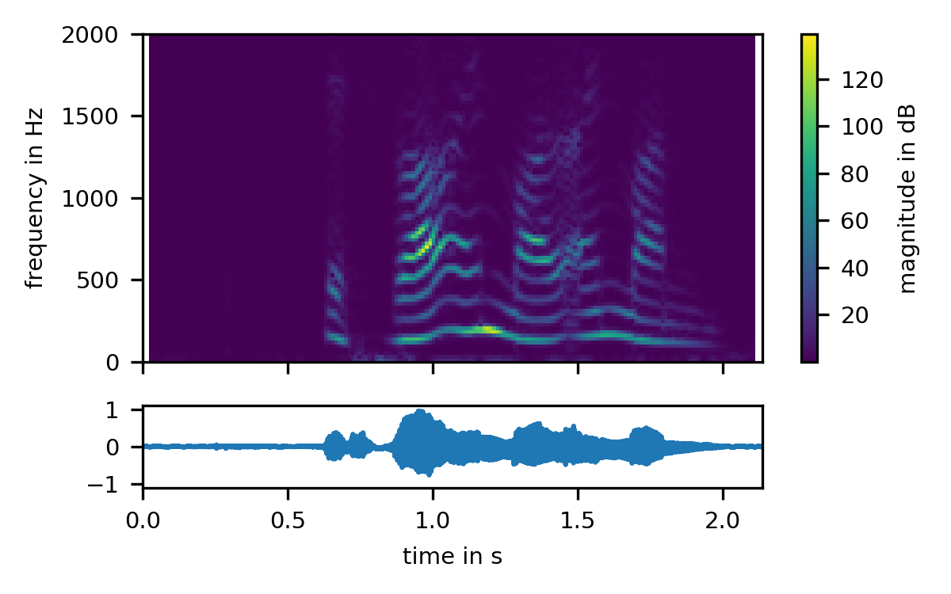
Background
Audio representations
Waveform vs. STFT
Waveform - suffers from memory usage
STFT - needs precise engineering
Temporal Dependencies
Audio is inherently sequential
Efficient Sequential Modeling
Gated DeltaNet
Flash Attention
Notes:
Tamerlan

Slide 5
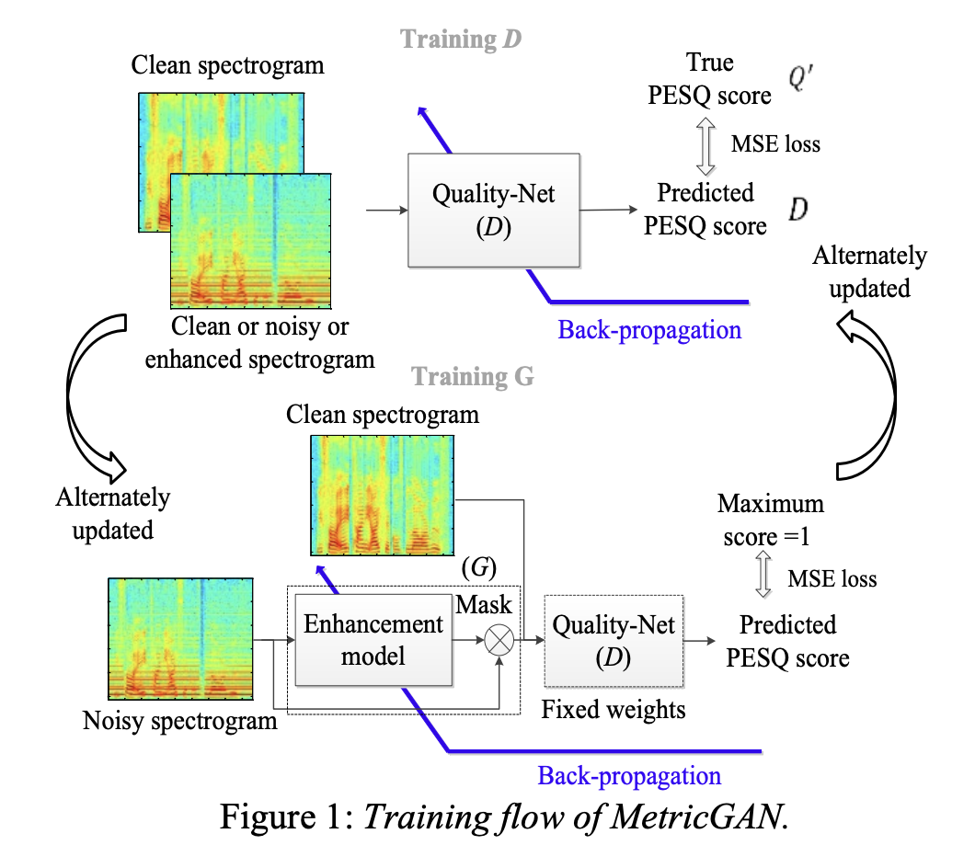
Baseline Model: MetricGAN+
Model trained to maximize a learned approximation of PESQ
Generator:
input: noisy speech
output: enhanced speech
Discriminator:
input: speech (cleaned or enhanced)
output: predicted metric score (e.g. PESQ)
Notes:
Punnisa
Paper with baseline weights
https://huggingface.co/norwoodsystems/norwood-speechVSnoise-AST-based/blob/main/model.safetensors (classification)
https://arxiv.org/abs/2104.03538 (denoising)
using speechbrain to download weights: https://github.com/speechbrain/speechbrain
Ablations (include here or later?)
CNN-only
VAE-only

Slide 6
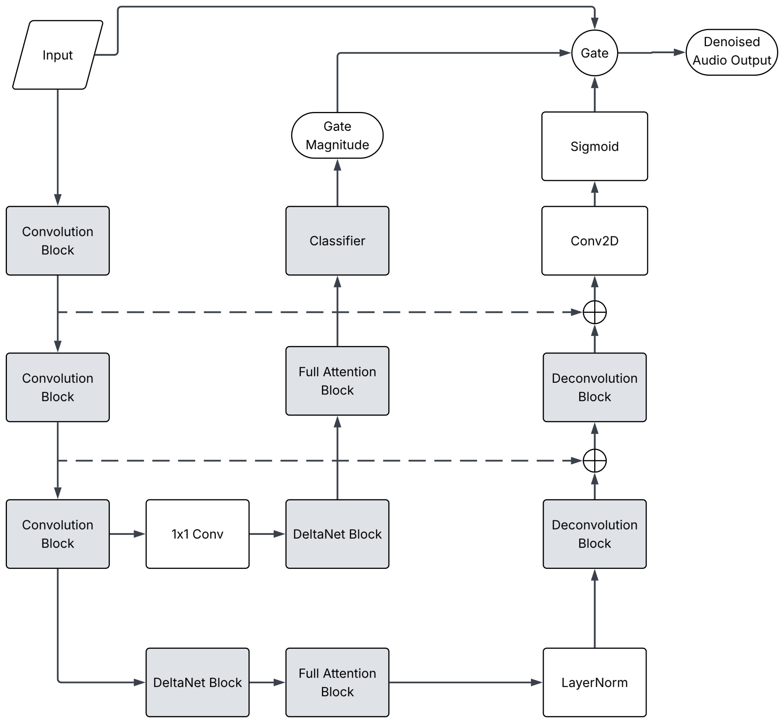
Our Model Architecture
Feature Extraction
3x convolution blocks
Noise Classification
DeltaNet + Full Attention
Denoising
DeltaNet + Full Attention
Deconvolution
Final Output
Notes:
Decoder/encoder - michael
CNN encoder to extract features of the audio to learn and reduce dimensions
inputs/outputs
attention and softgate - tamerlan
CNN decoder using transpose convolution to reconstruct the audio from some latent space

Slide 7
Training and Evaluation Setup
Optimizer: AdamW
Cosine Learning Rate Annealing
Loss function: L1 + spectral convergence
Saving parameters every 5 epochs
50 epochs total
Metrics:
Perceptual Evaluation of Quality (PESQ)
Signal Distortion MOS prediction (CSIG)
Background Intrusiveness MOS prediction (CBAK)
Overall Quality MOS prediction (COVL)
Notes:
Mint
MOS : mean opinion score
audio from 1-5 1:bad, 5:good
spectral convergence: how predicted spectogram is close to the clean spectogram
PESQ: How close does this sound to clean speech, perceptually?
CSIG: How natural and undistorted does the speech sound? speech signal distortion
CBAK: How much does the background noise interfere?
COVL: Overall, how good does this audio sound?

Slide 8
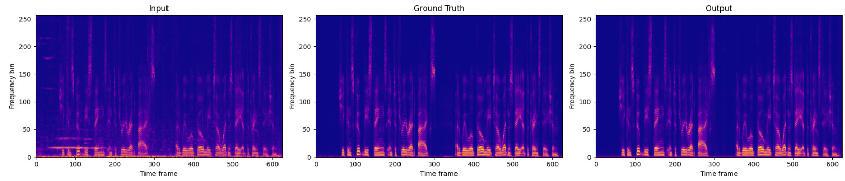

Results: Testing Set Spectrograms
Notes:
Mint

Slide 9
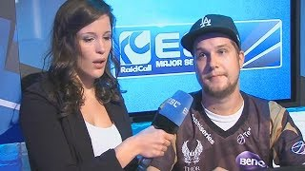
Results: Inference
Input:
Output:
Notes:
Tamerlan

Slide 10
Results: Model vs. Baseline
PESQ | Original | People Speech | CSRT VCTK
Our Model | 3.1383 | 2.0107 | 3.3475
Baseline | 1.996 | 1.9709 | 2.8508
CSIG | Original | People Speech | CSRT VCTK
Our Model | 4.5913 | 3.5850 | 4.9634
Baseline | 3.367 | 3.3451 | 4.0384
Notes:
Michael - Talk about range of each metric
PESQ range: 1 - meaning the person hearing this cannot understand 4.5 - where a person can understand without trying
CSIG range: 1 - meaning heavy signal distortion; 5 - meaning little to no signal distortion
CBAK range: 1 - heavy background noise/intrusion; 5 - meaning background noise not noticeable
COVL range: 1 - bad mean opinion score (measure of human perceived quality of audio), so not good; 5 - good mean opinion score (people hear this audio and think it is excellent quality)
CSRT VCTK - center for speech technology research, voice cloning toolkit
people speech - hugging face
original - the samples not used in the training for our model but come from that dataset

Slide 11
Results: Model vs. Baseline
CBAK | Original | People Speech | CSRT VCTK
Our Model | 3.9756 | 3.5016 | 4.9923
Baseline | 2.625 | 3.0535 | 3.5814
COVL | Original | People Speech | CSRT VCTK
Our Model | 3.9236 | 2.8081 | 4.2822
Baseline | 2.644 | 2.6374 | 3.4311
Notes:
Michael

Slide 12
Issues and Future Work
Does not generalize well across all types of noise
Different types of datasets to test robustness
Other languages, environmental factors, etc.
Live inference
STFT (pos + complex vals) compared to magnitude STFT
More Ablations:
Deeper layers for Encoder and Decoder
More Attention layers
Utilize state space architecture
Notes:
Tamerlan

Slide 13
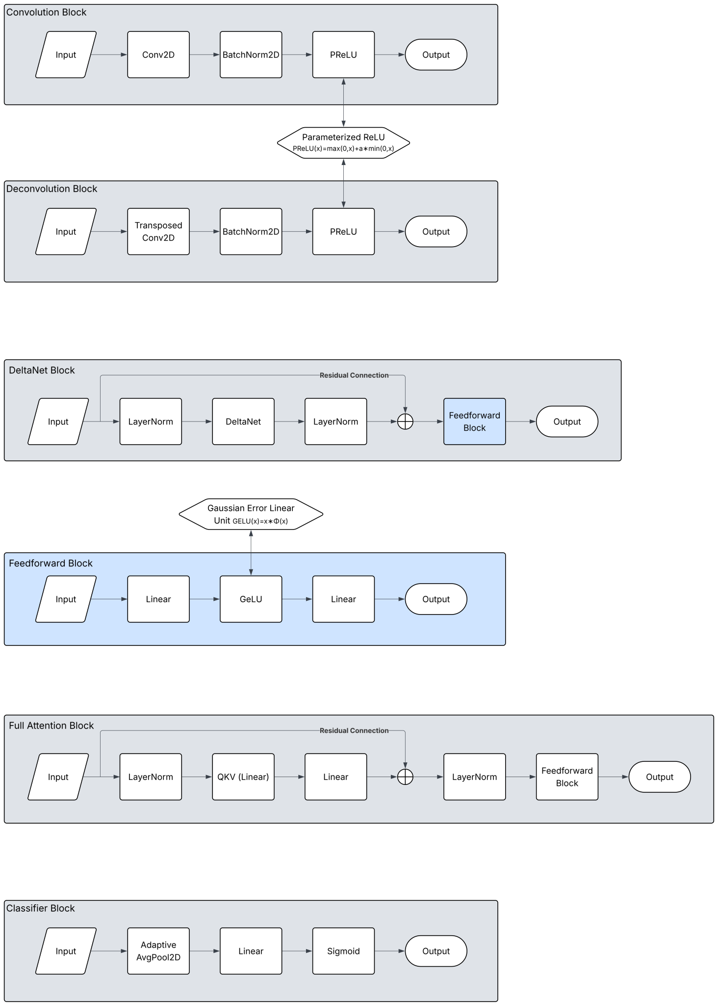
Model Architecture Expanded

